Slide 1
Opioid Abatement Council
Mary Shelton, Executive Director
Notes:
Good afternoon,
Thank you, Brian for the lovely introduction. It’s been helpful to have his perspective represented on the Council.
I’m honored to be in this role and serving as the Executive Director of the Opioid Abatement Council
I know many of you from my time at TennCare where I was the Director of Behavioral Health Operations for 14 years.
Similar to that role, I’m charting new territory. As many of you may remember, I didn’t have all the answers back in 2008 when I started at TennCare, but we eventually figured it out together.
Likewise, I have the same dedication to this role and know all of the questions you have will be answered – hopefully sooner rather than later.

Slide 2
Responsibility of Council
The Council upholds the responsibility to ensure the disbursements of these funds go toward funding programs, strategies, expenditures, and other actions designed to prevent and address the misuse and abuse of opioid products and treat or mitigate opioid use or related disorders or other effects of the opioid epidemic.
Public Chapter 491 of 2021
2

Slide 3
Responsibility of Council
Opioid Abatement Funds can be spent for the following purposes:
Prospective opioid abatement and remediation;
Expenses incurred in administering and operating the opioid abatement council;
Related expenses associated with administering, investing, and disbursing funds held in the abatement fund;
Executive director and support staff for the Opioid Abatement Council.
3

Slide 4
Opioid Abatement Trust Fund
The Council is entrusted to manage
the funds in the Opioid Abatement
Trust Fund
Notes:
I’m pulling out this pie-chart so you can see it more clearly. This is the part of the funds coming to TN that comprise the Trust Fund. This is what the Opioid Abatement Council is managing.
As announced in Monday’s meeting, there is $43,852,576 in the Trust Fund as of October 31, 2022.
There has been another deposit since, so we will have an updated figure showing the November ending balance in a few days.

Slide 5
Posting County Data on OAC Website

Slide 6
County Level Reporting
Overview
Objective: Visual Data Dashboard on county-level disbursement, allocation, and spend of state provided funding. Data will be updated as annual and semi-annual allocations are made available.
Data Sources:
County Fund Disbursements
County Semi-Annual Reports
Output:
Interactive dashboard within SAS Visual Analytics that allows TN OAC users to perform data exploration and analysis on county data.
Dashboards are dynamic to view data slices of spend by county and year.
Static PDF Output for distribution and circulation as determined by the TN OAC.

Slide 7
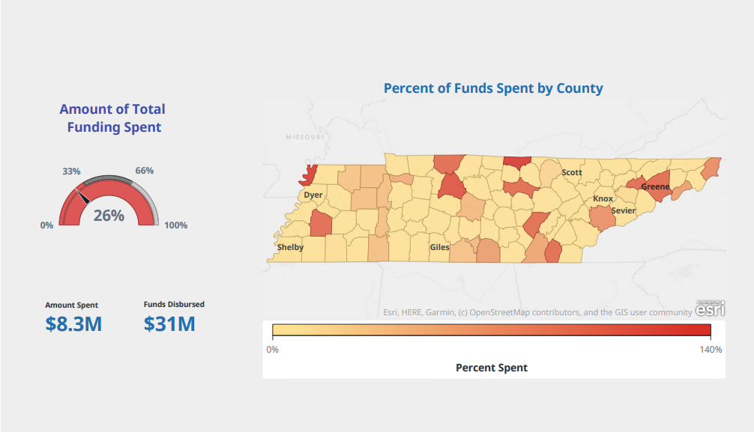
County Level Report Demo
Statewide View

Slide 8
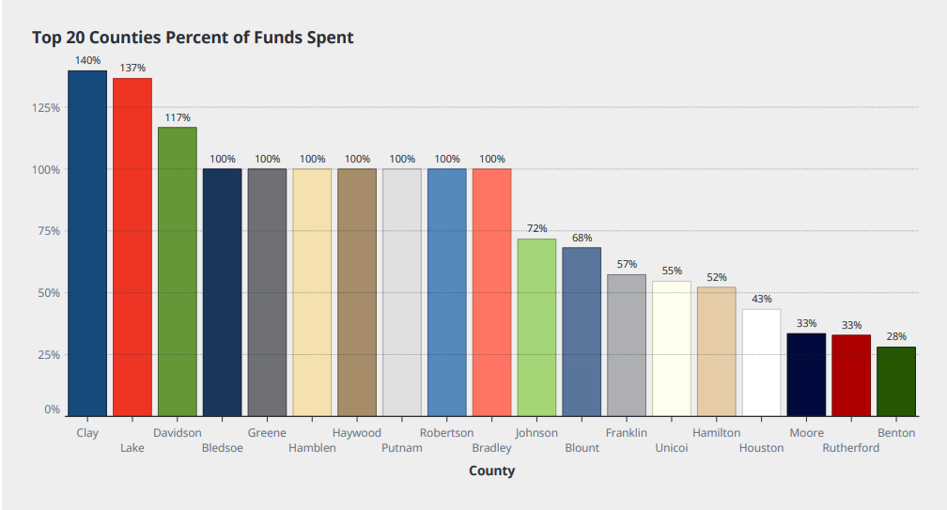
County Level Report Demo
Top 20 Counties by Percent of Funds Spent

Slide 9
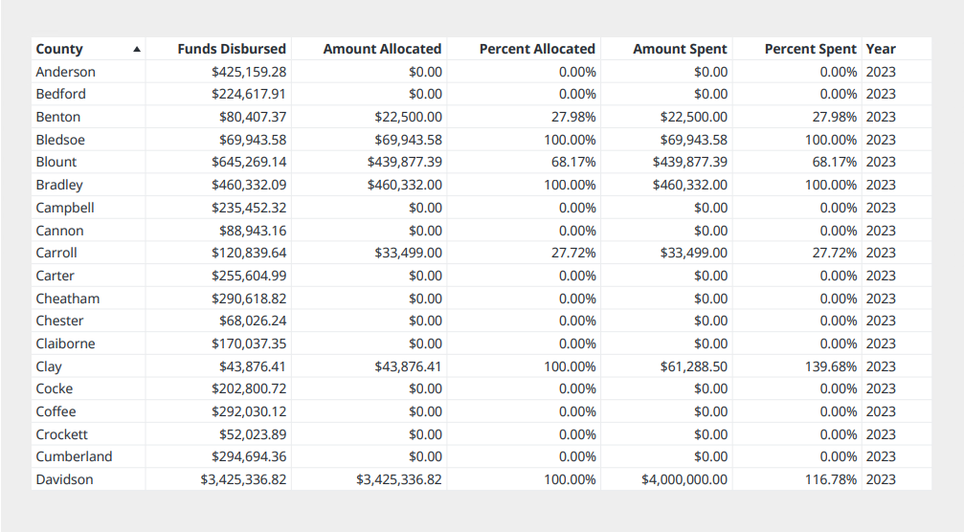
County Level Report Demo
Tabular Detailed View

Slide 10
Timeline for Posting County Data
The Opioid Abatement Council Office expects to post the County Level data in August 2024
The County Level data will be updated with each Semi-Annual Report

Slide 11
Interest Earned on Trust Fund Disbursements

Slide 12
Questions about Interest Earned
The Opioid Abatement Council Office has received questions about the interest earned.
The questions include when to allocate and spend the interest
The OAC Office will work with other state leaders to determine the guidance for the interest
The OAC Office will notify the counties as soon as there is guidance

Slide 13
Contact Information
Email: Opioid.abatement@tn.gov
Website: https://www.tn.gov/oac.html

